Slide 1
Open science, open source Using open source software to implement machine learning risk prediction models at the Uppsala ambulance service
Douglas Spangler

Slide 2
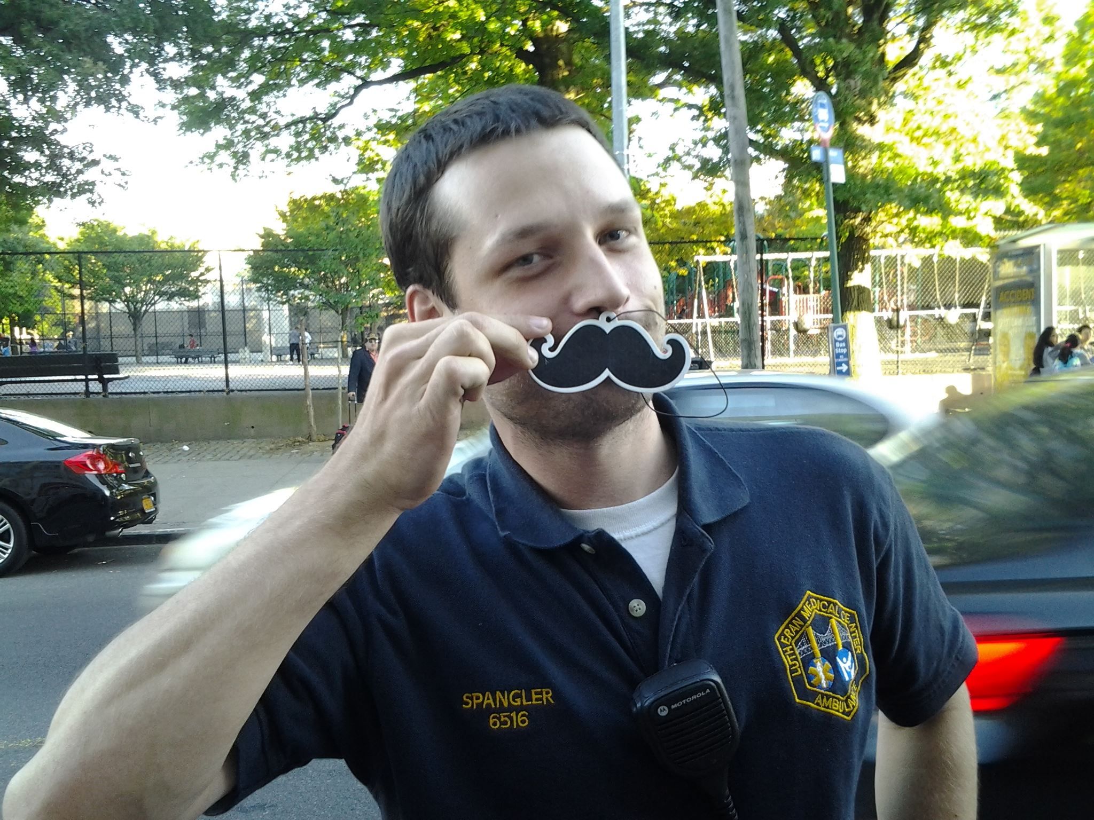
About me
Douglas Spangler
Region Uppsala
Verksamhetsutvecklare
Paramedic
Uppsala University
PhD student Research assistant

Slide 3
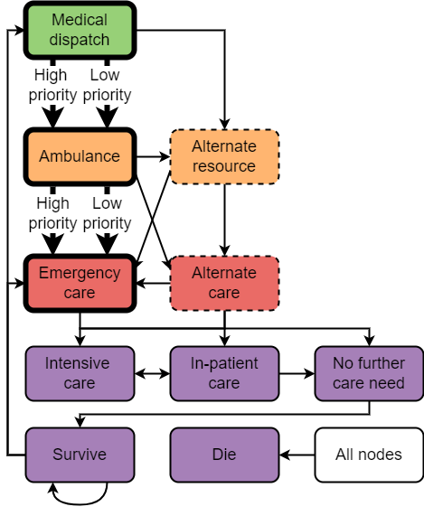
Prehospital care
Traditionally a simple process
Increasingly complex chains of care
Multiple aspects of ”care need” and outcomes to consider

Slide 4
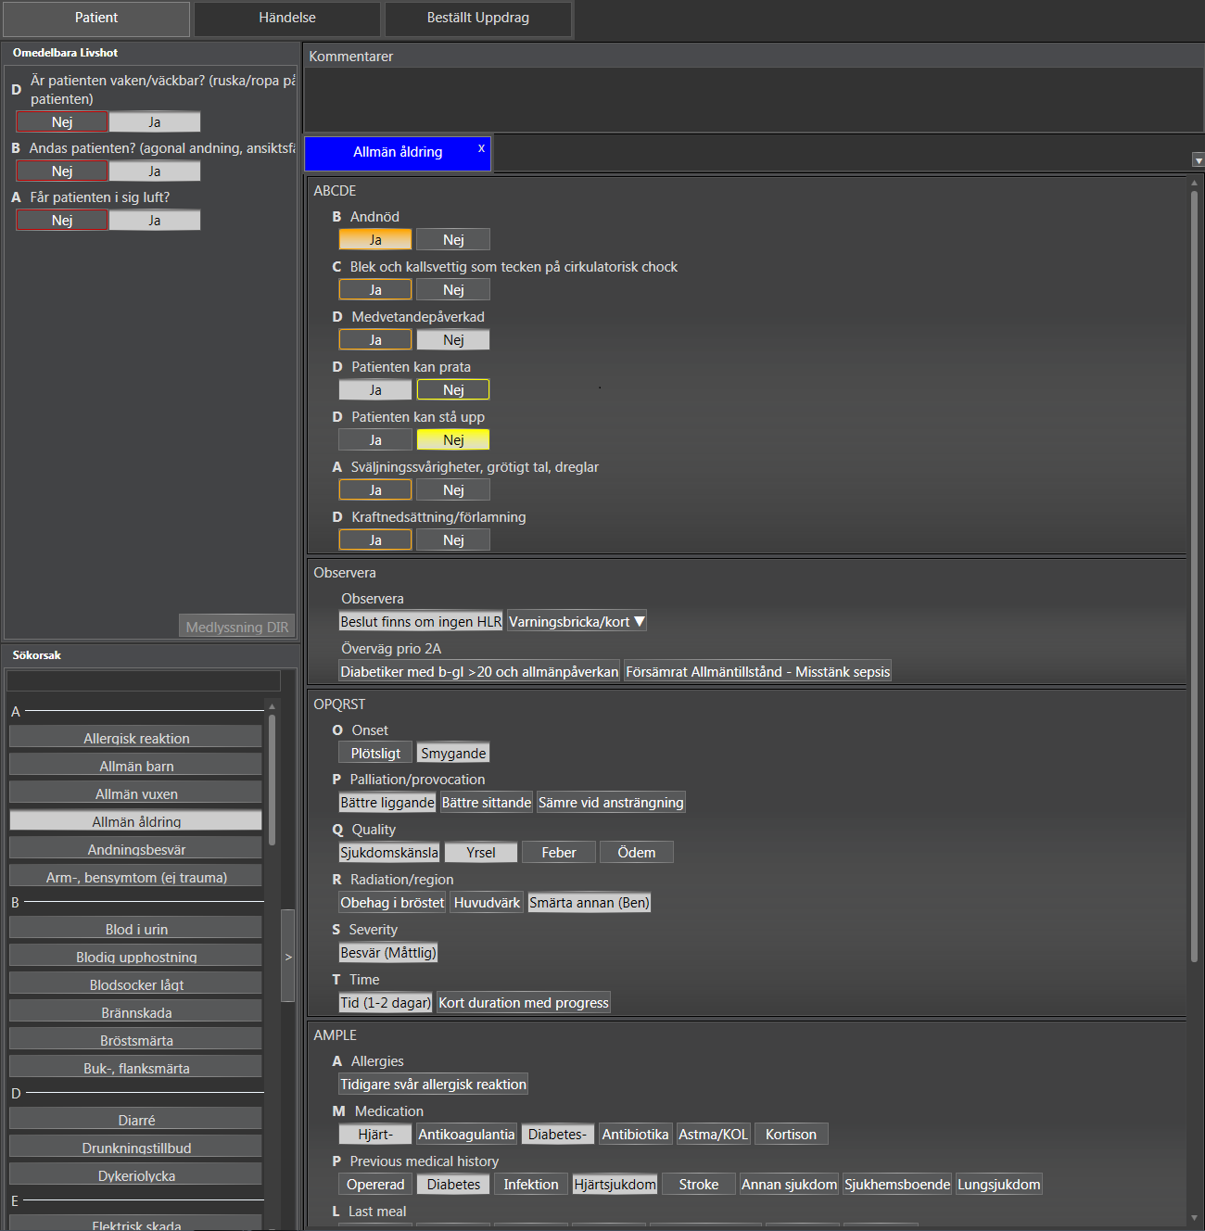
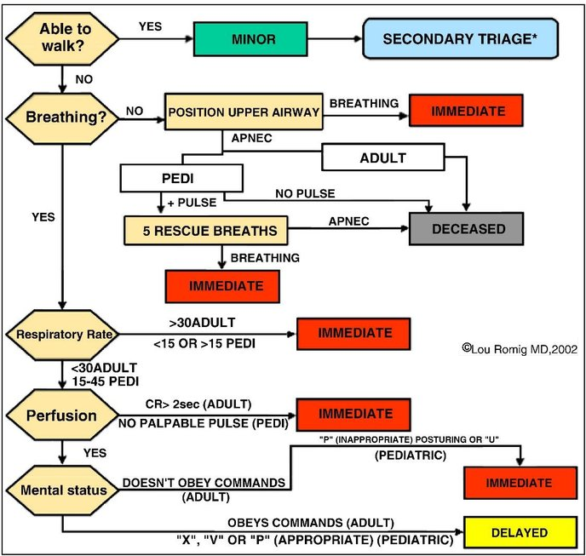
Decision support in prehospital care
Time sensitive prioritization decisions
Rule-based systems – Limited precision but simple
Patients compete for scarce resources – Multiple patients with same priority?

Slide 5
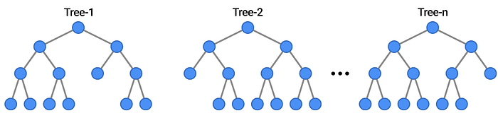
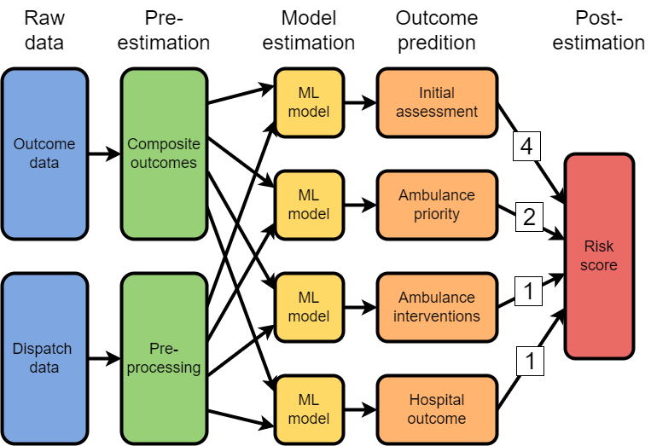
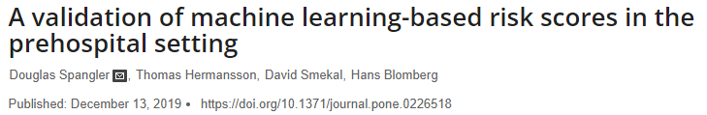
Machine learning
Just cram everything into a gradient boosting model
How to define the need for an ambulance? (Alignment)
Also:
Performance
Generality
Fairness
Does it work IRL?

Slide 6
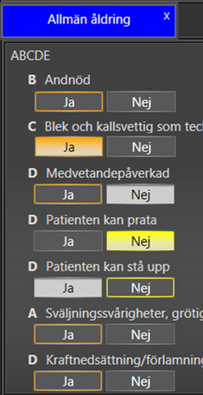
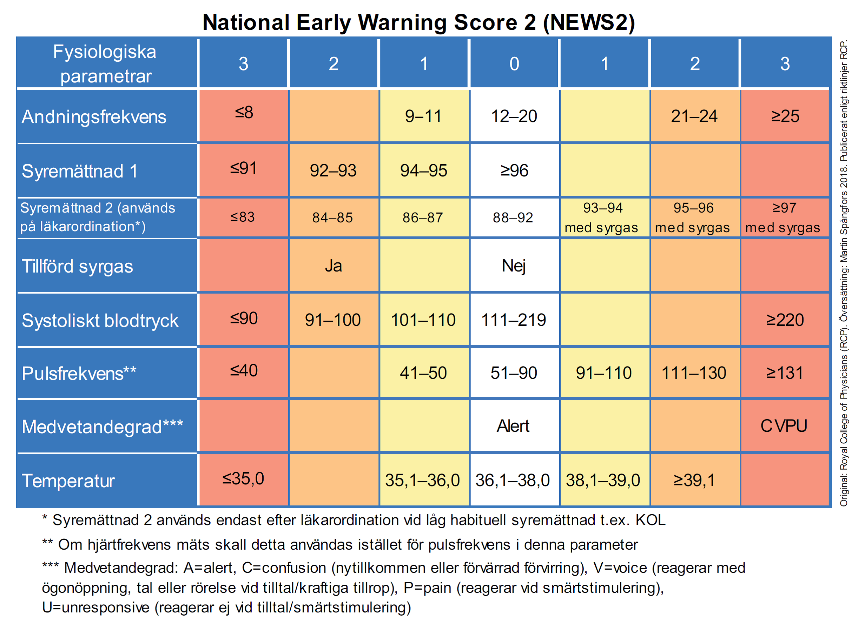
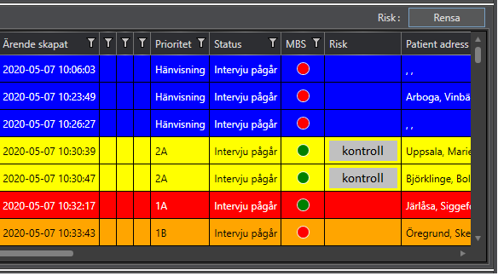
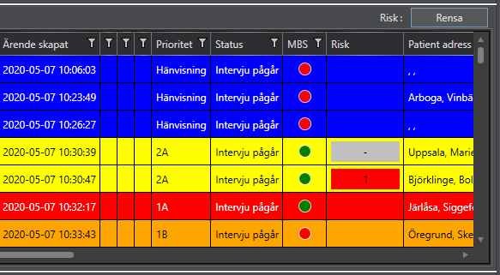
Machine learning Assisted Differentiation of Low-Acuity patients at Dispatch (MADLAD): A Randomized Control Trial
Aim: Does information about risk scores improve triage accuracy?
Sample: 1500 ”resource constrained situations” in Uppsala and Västmanland
Method: RCT – With or without information from the tool
Randomize

Slide 7
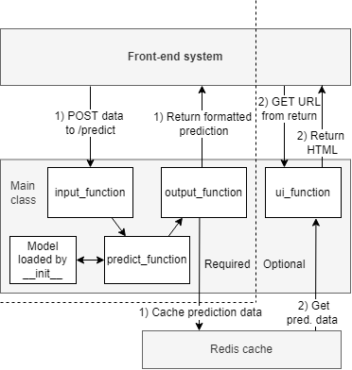
Requirements
openTriage
Containerized
REST API
Mostly Python
Handle relatively lightweight models
On premesis deployment
Able to adapt to multiple use cases
Simple and stable
Cheap
Ugh… Lets just build it ourselves
openTriage - Ambulance referral risk

Slide 8
Problems with healthcare IT
Lack of scale in regions
Lack of collaboration between regions
Lack of national / EU leadership
Reliance on consultants for expertise
Inflexible procurement process
Vendor lock-in

Slide 9
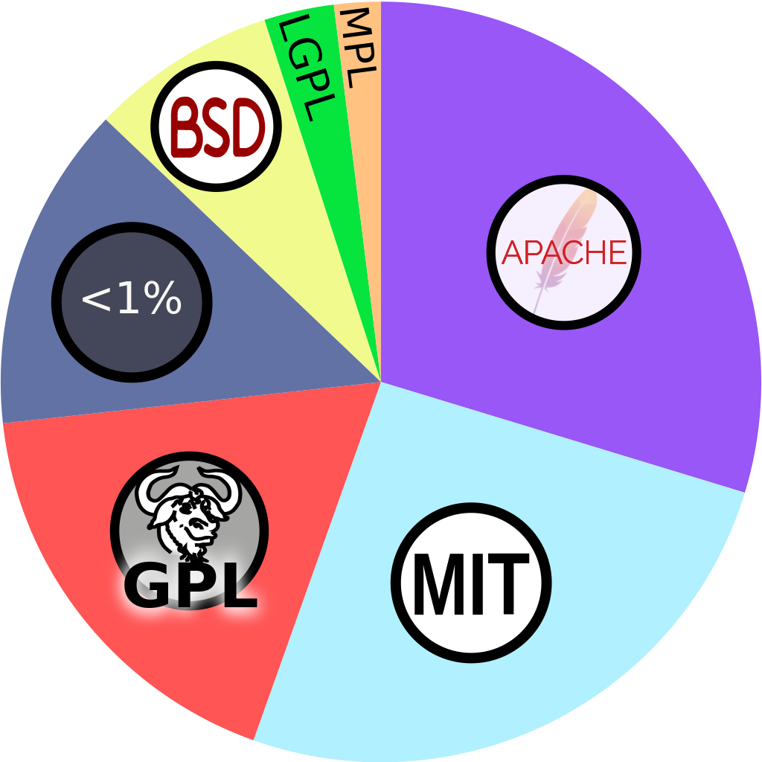
Open source software
Free as in speech - Free as in beer
Different flavors of license
Permissive
Copyleft
Creative Commons*
Widely used everywhere (except in healthcare)

Slide 10
A framework for regional cooperation
Inspiration: Stiftelsen Norsk Luftambulans
But we dont have oil… We have bureaucracy
The Hamburg-exception in the Public Procurement Act
Cooperation agreements between public agencies avoid Upphandling
Financing development & support – What organization?

Slide 11
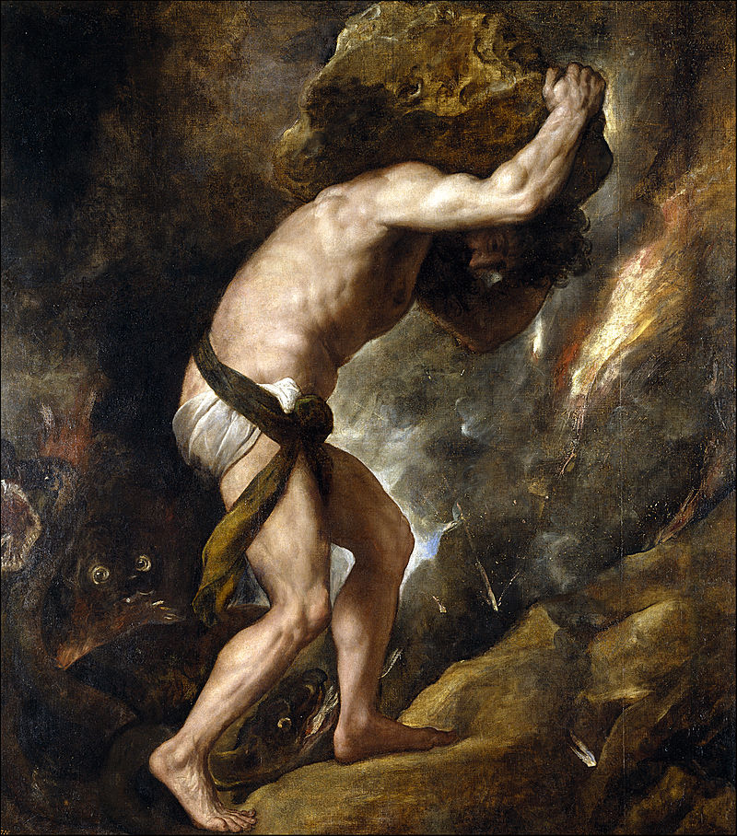
Challenges
Medical device regulations
Bootstrapping development resources
Companies will go to court to protect profits
A lot of hard work and little personal gain

Slide 12
Cheers
Source code: https://github.com/dnspangler/openTriage
Demo: https://opentriage.net/ui/vitals
Validation study: https://doi.org/10.1371/journal.pone.0226518
RCT protocol: https://clinicaltrials.gov/study/NCT04757194
douglas.spangler@akademiska.se

